Slide 1
Golang Training Pointers
24/01/2023

Slide 2
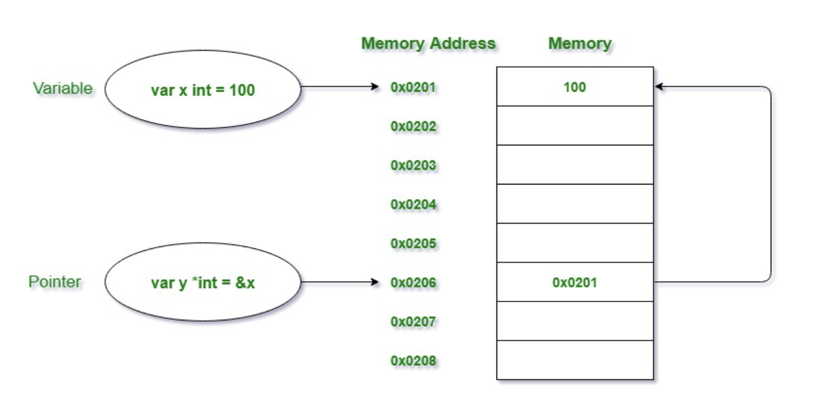
Golang: Pointer
Overview
Pointer is a variable that stores the address of another variable
2

Slide 3
Golang: Pointer
Declaring pointer
Pointer to a type is declared by prefixing * to type
E.g.
a := 10
var intPtr *int // Integer pointer
intPtr = &a. // & return reference(address) of a
b:= "Hello"
var stringPtr *string// string pointer
stringPtr = &b //& return reference of b
3

Slide 4
Golang: Pointer
Dereferencing Pointer
a := 10
var intPtr *int // Integer pointer
intPtr = &a. // & return reference(address) of a
c := *intPtr // dereferencing pointer
b:= "Hello"
var stringPtr *string// string pointer
stringPtr = &b //& return reference of b
d := *stringPtr // dereferencing pointer
4

Slide 5
Golang: Pointer
Important Note
Pointer arithmetic is not possible (C and C++ Supports Pointer arithmetic)
Pointers are special variables in Golang
'&' // referencing operator
'*' // dereferencing operator
5

Slide 6
Golang: Array
An array is collection of objects of same type
Array has a fixed size/length
Array can neither expand not shrink
Array is specified by prefixing size in square brackets before the type.
var array [size]type
Eg. var arrayInt [10]int
var arrayString [10] string
6

Slide 7
Golang: Array
Initializing array with array literal
Initializing specific elements of array
Copying Array
By value
By reference
len function and range operator
7

Slide 8
Golang: Slice
Overview
Slice is a variable-length sequence which stores elements of a similar type
Slice is a lightweight data structure
Slice contains 3 elements
Pointer: The pointer is used to points to the first element of the array that is accessible through the slice
Length: The length is the total number of elements present in the array.
Capacity: The capacity represents the maximum size upto which it can expand.
8

Slide 9
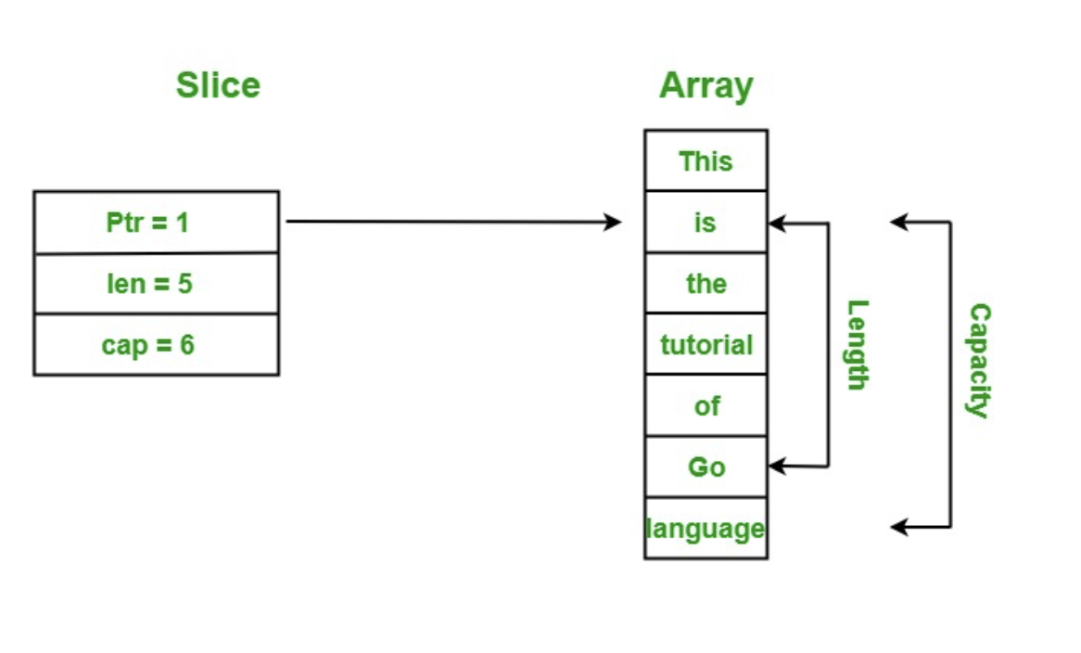
Golang:Slice
9

Slide 10
Golang:Slice
Declaring slice
Slice can be declared like an array, however size is not specified
var my_slice_1 = []string{"Mavenir", "Golang", "Training"}
Using make function to create slice
func make([]T, len, cap) []T
Slice can be created using existing array
array_name[lowIdx:highIdx]
Slice can be created using existing slice
slice_name[low:high]
Declare Slice using new Keyword
var intSlice = new([50]type)[0:10]
Slice can be iterated like a array
10

Slide 11
Golang:Slice
Important points
Zero value slice: In Go language, you are allowed to create a nil slice that does not contain any element in it
var myslice []string
Modifying Slice:
slice is a reference type
changing some elements in the slice, will change content of underlying array
Comparison of Slice: In Slice, you can only use == operator to check the given slice is nill or not
Multi-Dimensional Slice: Multi-dimensional slice are just like the multidimensional array,
Sorting of Slice: In Go language, you are allowed to sort the elements present in the slice using sort package
11

Slide 12
Golang:Slice
Add/Remove/Copy
To add an item to the end of the slice, use the append() method.
Removing element at index
append(s[:index], s[index+1:]...)
Slice can be copied using copy()
12

Slide 13
Golang:Slice
Sort/Search/Reverse
Sort package provides functions to sort/search/reverse
Ints function [ascending order]
func Strings(strSlice []string)
Float64s function [ascending order]
IntsAreSorted function
StringsAreSorted function
Float64sAreSorted function
SearchInts(intSlice []int, x int) int
SearchStrings(strSlice []string, x string) int
SearchFloat64s(fltSlice []float64, x float64) int
Reverse(data Interface) Interface
Revisit sort search reverse after structures
13

Slide 14
Golang:Slice
Important functions
make() used to create slice
append() used to append elements
copy() used to copy
len() returns length of slice
range used as similar to arrays
14

Slide 15
Golang: structure
Overview
A structure or struct in Golang is a user-defined type
Groups items of possibly different types into a single type
Any real-world entity which has some set of properties/fields can be represented as a struct.
Syntax
type <struct-name> struct {
Property1 type
Property2 type
}

Slide 16
Golang: Structure
Declaration
Structure type variables can be declared as below
Eg.
type Address struct { name, street, city, state string Pincode int }
var a Address = Address {name: "Sanjana S", street: "HSR", city: "Bangalore", state: "Karnatak", Pincode:560102 }
Struct Instantiation Using new Keyword
addr := new(Address) // here addr is pointer to struct.

Slide 17
Golang:Structe
Discussion points
Declaration of a Struct Type
Creating a Struct Instance Using a Struct Literal
Struct Instantiation Using new Keyword
Struct Instantiation Using Pointer Address Operator
Nested Struct Type
Comparing Structs with the Different Values Assigned to Data Fields
Copy Struct Type Using Value and Pointer Reference
Anonymous Structure and Fields
Promoted Fields in Structure
17

Slide 18
Golang:Functions
Overview
Functions are generally the block of codes or statements
In a program that gives the user the ability to reuse the same code
saves the excessive use of memory
provides better readability of the code
Syntax:
func function_name(Parameter-list)(Return_type){ // function body..... }
func: It is a keyword in Go language, which is used to create a function.
function_name: It is the name of the function.
Parameter-list: It contains the name and the type of the function parameters.
Return_type: It is optional and it contain the types of the values that function returns. If you are using return_type in your function, then it is necessary to use a return statement in your function.
18

Slide 19
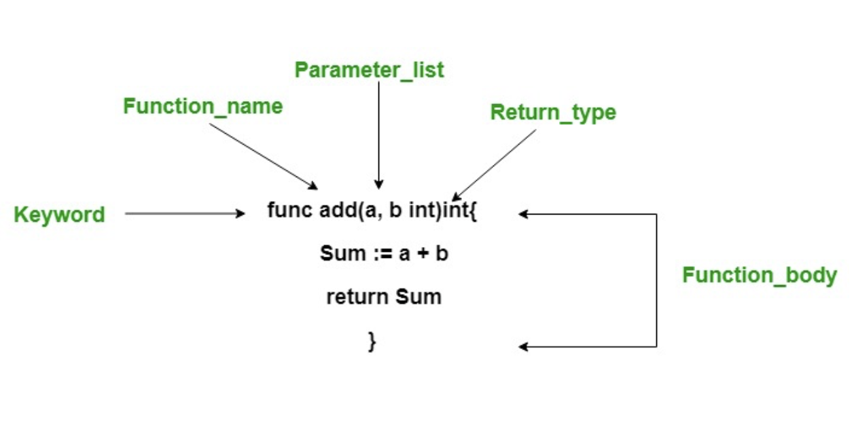
Golang:Functions
19

Slide 20
Golang: Functions
Call by Value/Call by reference
Call by value
values of actual parameters are copied to function’s formal parameters
Both parameters are stored in different memory locations.
Any changes made inside functions are not reflected in actual parameters of the caller.
Call by reference
Both the actual and formal parameters refer to the same locations
Any changes made inside the function are actually reflected in actual parameters of the caller.

Slide 21
Golang: Functions
Anonymous function
Go language provides a special feature known as an anonymous function
Anonymous function doesn’t contain any name
It can be compared with an inline function
an anonymous function can form a closure
An anonymous function is also known as function literal
Syntax:
func(parameter_list)(return_type){ // code.. // Use return statement if return_type are given // if return_type is not given, then do not // use return statement return }()

Slide 22
Golang: Functions
Anonymous Functions
Anonymous function can be assigned to a variable.
type of the variable is of function type
Anonymous function can be called using assigned variable
Can pass arguments in the anonymous function.
Can pass an anonymous function as an argument into other function.
Can return an anonymous function from another function.

Slide 23
Golang: functions
Function Returning Multiple Values
It is allowed to return multiple values from a function
Single return statement can return multiple values
Syntax
func function_name(parameter_list)(return_type_list){ // code... }
function_name: It is the name of the function.
parameter-list: It contains the name and the type of the function parameters.
return_type_list: It is optional and it contains the types of the values that function returns. If you are using return_type in your function, then it is necessary to use a return statement in your function.

Slide 24
Golang: Functions
Name to the Return Values
It is allowed provide names to the return values.
Names of the return values can be used as variable names in your code
And this type of return is known as the bare return
Syntax
func function_name(para1, para2 int)(name1 int, name2 int){ // code... }
func function_name(para1, para2 int)(name1, name2 int){ // code... }

Slide 25
Golang: Functions
Variadic arguments
function that is called with the varying number of arguments
Eg.
fmt.Printf, fmt.Println
The type of the last parameter is preceded by an ellipsis
Syntax
function function_name(para1, para2...type)type {
// code...
}

Slide 26
Golang: Functions
When to use variadic functions
Variadic functions can be used instead of passing a slice to a function.
Variadic function is used when we don’t know the number of parameters.
It increases the readability of your program.

Slide 27
Golang: Functions
Topics to cover
Array as argument to function
Returning Array
Slice as argument to function
Returning slice
Structure as argument
Returning structures

Slide 28
Golang: Functions
Methods
Go methods are similar to Go function with one addition of a receiver argument in it
Method can access the properties of the receiver
Receiver can be of struct type or non-struct type
Syntax:
func(reciver_name Type) method_name(parameter_list)(return_type){ // Code }
Method with Non-Struct Type Receiver
Method with struct type receiver
Methods with Pointer Receiver

Slide 29
Golang: Functions
Methods with same name
it is allowed to create two or more methods with the same name in the same package
receiver of these methods must be of different types
Syntax:
func(reciver_name_1 Type) method_name(parameter_list)(return_type){ // Code }
func(reciver_name_2 Type) method_name(parameter_list)(return_type){ // Code }

Slide 30
Golang: Functions
defer
defer statements delay the execution of the
function
method
anonymous method
defer function or method call arguments evaluate instantly
Multiple defer statements are allowed in the same program and they are executed in LIFO(Last-In, First-Out)
In the defer statements, the arguments are evaluated when the defer statement is executed, not when it is called.
Defer statements are generally used to ensure the cleanup

